Slide 1
HTML Table
Notes:
Sbsb x zb

Slide 2
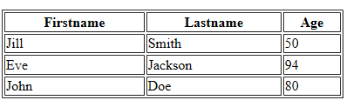
HTML Table
define using <table>……</table>
each table row is defined with the <tr> tag
a table header is defined with the <th> tag
(by default, table headings are bold and centered )
a table data/cell is defined with the <td> tag
Example

Slide 3
Attributes of table element
bgcolor | red / blue / ….
background | .jpg / .jpeg/ .png/ .gif
border (Specifies whether or not the table is being used for layout purposes) | 0 or 1
width | Pixels or %
height | Pixels or %
cellspacing (Specifies the space between cells) | Pixels
cellpadding (Specifies the space between the cell wall and the cell content) | Pixels
align | right/ left/ center

Slide 4
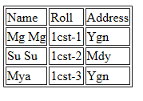
Sample Code
<body>
<table border=“1”>
<tr>
<td> Name </td>
<td> Roll </td>
<td> Address</td>
</tr>
<tr>
<td> Mg Mg </td>
<td> 1cst-1</td>
<td> Ygn</td>
</tr>
<tr>
<td> Su Su </td>
<td> 1cst-2</td>
<td> Mdy </td>
</tr>
<tr>
<td> Mya </td>
<td> 1cst - 3</td>
<td> Ygn </td>
</tr>
</table>
</body>
Output:

Slide 5
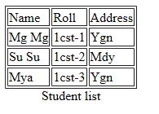
Table with Caption Element
<body>
<table border=“1”>
<caption align=“bottom”>
Student list
</caption>
<tr>
<td> Name </td>
<td> Roll </td>
<td> Address</td>
</tr>
<tr>
<td> Mg Mg </td>
<td> 1cst-1</td>
<td> Ygn</td>
</tr>
<tr>
<td> Su Su </td>
<td> 1cst-2</td>
<td> Mdy </td>
</tr>
<tr>
<td> Mya </td>
<td> 1cst - 3</td>
<td> Ygn </td>
</tr>
</table>
</body>
Output:
Align: right/ left/ top/ bottom

Slide 6
Attributes of tr (Table Row) Element
bgcolor | red / blue / ….
background | .jpg / .jpeg/ .png/ .gif
align | right/ left(default)/ center
valign | top / middle(default) / bottom

Slide 7
Attributes of td and th Elements
td = table cell
th = table heading (bold)
bgcolor | red / blue / ….
background | .jpg / .jpeg/ .png/ .gif
align | right/ left(default)/ center
colspan (Cells that Span Many Columns.) | numeral(2 to …)
rowspan (Cells that Span Many Rows.) | numeral(2 to …)
valign | top / middle(default) / bottom

Slide 8
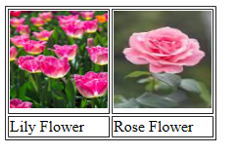
Sample Code- inserting Image into table cell
<body>
<table border="1">
<tr>
<td> <img src="flower1.jpg" height="100" width="100" title="Lily" > </td>
<td> <img src="flower3.jpg" height="100" width="100" title="Rose" > </td>
</tr>
<tr>
<td> Lily Flower</td>
<td> Rose Flower</td>
</tr>
</table>
</body>
Output:

Slide 9
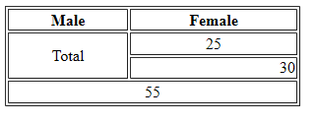
Sample Code- using rowspan and colspan
<body>
<table border=“1” width=“300”>
<tr>
<th>Male</th>
<th>Female</th>
</tr>
<tr align=“center” >
<td rowspan=“2”> Total </td>
<td> 25 </td>
</tr>
<tr>
<td align=“right”> 30 </td>
</tr>
<tr align=“center”>
<td colspan=“2”> 55 </td>
</tr>
</table>
</body>
Output:

Slide 10
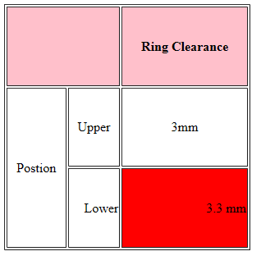
Sample Code- using rowspan and colspan and bgcolor
<body>
<table border=“1”
width=“300” height=“300”>
<tr bgcolor=“pink”>
<th colspan=“2”> </th>
<th> Ring Clearance </th>
</tr>
<tr align=“center” >
<td rowspan=“2”> Postion </td>
<td> Upper </td>
<td> 3mm </td>
</tr>
<tr align=“right”>
<td> Lower </td>
<td bgcolor=“red”> 3.3 mm </td>
</tr>
</table>
</body>
Output:

Slide 11
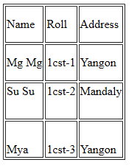
Sample Code -using Vertical Align (valign)
<body>
<table border=“1”>
<tr height="50">
<td> Name </td>
<td> Roll </td>
<td> Address</td>
</tr>
<tr height="50">
<td> Wai </td>
<td> 1cst-1</td>
<td> Yangon</td>
</tr>
<tr height="50">
<td valign=“top”> Su Su </td>
<td valign=“top”> 1cst-2</td>
<td valign=“top”> Mandalay </td>
</tr>
<tr height="50">
<td valign=“bottom”> Mya </td>
<td valign=“bottom”> 1cst - 3</td>
<td valign=“bottom”>Yangon</td>
</tr>
</table>
</body>
Output:

Slide 12
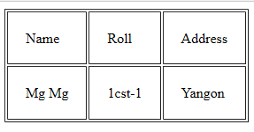
Sample code –using cellpadding
<body>
<table border=“1” cellpadding=“20”>
<tr>
<td> Name </td>
<td> Roll </td>
<td> Address</td>
</tr>
<tr>
<td> Mg Mg</td>
<td> 1cst-1</td>
<td> Yangon</td>
</tr>
</table>
</body>
Output:

Slide 13
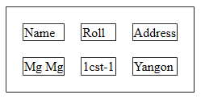
Sample Code- using cellspacing
<body>
<table border=“1” cellspacing=“20”>
<tr>
<td> Name </td>
<td> Roll </td>
<td> Address</td>
</tr>
<tr>
<td> Mg Mg </td>
<td> 1cst-1</td>
<td> Yangon</td>
</tr>
</table>
</body>
Output:

Slide 14
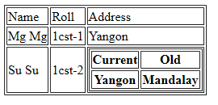
Sample Code- inserting another table into a table cell
<body>
<table border=“1”>
<tr>
<td> Name </td>
<td> Roll </td>
<td> Address</td>
</tr>
<tr>
<td> Mg Mg </td>
<td> 1cst-1</td>
<td> Yangon</td>
</tr>
<tr>
<td> Su Su </td>
<td> 1cst-2</td>
<td>
<table border=“1”>
<tr>
<th> Current</th>
<th> Old </th>
</tr>
<tr>
<th> Yangon </th>
<th> Mandalay </th>
</tr>
</table>
</td>
</tr>
</table>
</body>
Output:

Slide 15
<thead>, <tbody> and <tfoot> element
<thead> Groups the header content in a table
<tbody> Groups the body content in a table
<tfoot> Groups the footer content in a table

Slide 16
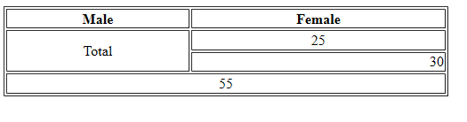
Sample Code- using <thead>, <tbody> and <tfoot> element
<body>
<table border=“1” width=“300”>
<thead>
<tr>
<th>Male</th>
<th>Female</th>
</tr>
</thead>
<tbody>
<tr align=“center” >
<td rowspan=“2”> Total </td>
<td> 25 </td>
</tr>
<tr>
<td align=“right”> 30 </td>
</tr>
</tbody>
<tfoot>
<tr align=“center”>
<td colspan=“2”> 55 </td>
</tr>
</tfoot>
</table>
</body>
Output:

Slide 17
Thank You!

